Slide 1
Hello
Python

Slide 2
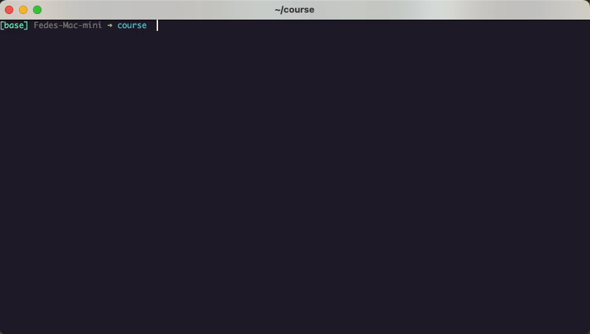
The classical starter: hello world

Slide 3
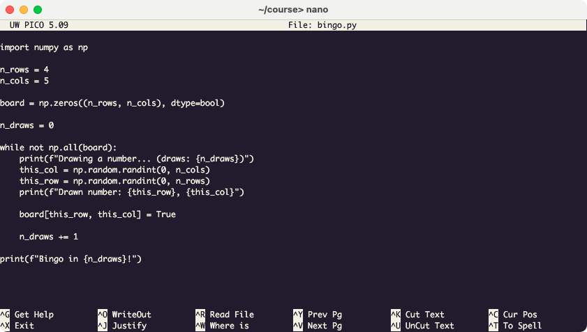
A more meaningful example: bingo

Slide 4
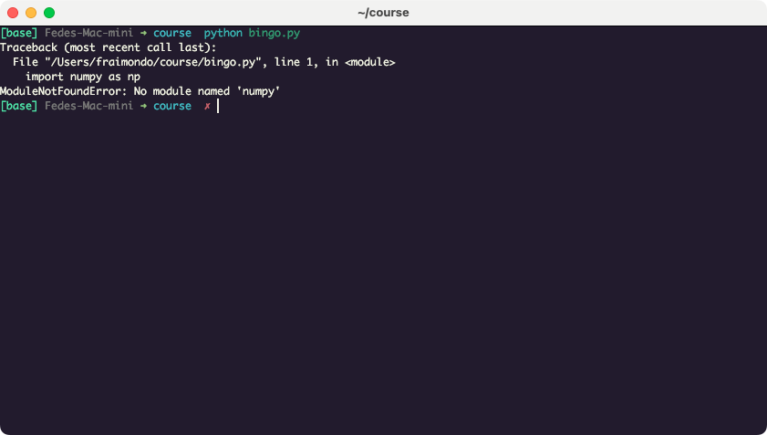
Lets play bingo!

Slide 5
Remember? What do we program?
User Program
Libraries
Operating System
Runtime
Environment
Platform
Input
Output
CPU
Memory
Keyboard
Network
Storage
Display
Hardware

Slide 6
Closer to the reality…
User Program
Libraries
Runtime
Environment
Operating System
Platform
Hardware

Slide 7
Even closer to the reality…
User Program
L
L
L
L
L
L
L
L
L
L
L
L
L
L
Runtime
Environment
Operating System
Platform
Hardware

Slide 8
I said CLOSER to the reality…
(can’t make it smaller)
User Program
L
L
L
L
L
L
L
L
L
L
L
L
L
L
Runtime
Environment
Operating System
Platform
Hardware

Slide 9


The cherry on the cake
Our program
The environment
(expectation)
(reality)

Slide 10
Multiple programs reality
User Program A
User Program B
L
L
L
L
L
L
L
L
L
L
L
L
L
L
Runtime
Environment
Operating System
Platform
Hardware

Slide 11
Multiple realities (environments)
User Program A
User Program B
L
Virtual
Environment
A
L
L
L
L
L
L
L
L
L
L
L
L
L
Runtime
Environment
Operating System
Platform
Hardware

Slide 12
Multiple realities (environments)
User Program B
L
Virtual
Environment
B
L
L
L
L
L
Runtime
Environment
Operating System
Platform
Hardware

Slide 13
Back to bingo
We need to install numpy
We need a “package manager”
pip
conda/mamba
pipenv
poetry
Beware!
We also need a “virtual environment manager”
virtualenv
conda/mamba
pipenv
poetry

Slide 14
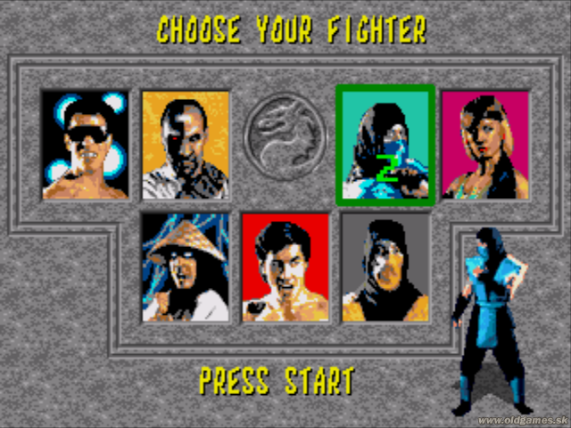
What to choose?
 | pip | virtualenv | conda / mamba | pipenv | poetry
Easy to install / setup
Latest-packages available |  |  | *
Virtual environment manager
Handles packages dependencies
Small installation size |  |  | **
Multi-platform
Access to PyPI |  |  | ***
Easily reproduce environments
Re-usable environment
* can be solved
** using miniforge
*** through pip

Slide 15
Virtual Environments with conda/mamba
conda create –n course python=3.12
conda activate course
conda install numpy
conda env list
conda list
conda update <PACKAGE>
conda search <PACKAGE>
conda remove <PACKAGE>

Slide 16
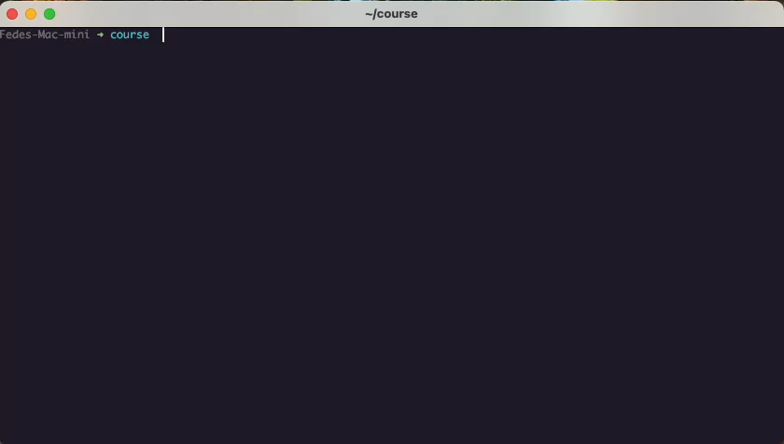
Virtual Environments with conda/mamba

Slide 17

Coding made easier…
Source
Code

Slide 18
Coding made easier…
“A development environment is a collection of procedures and tools for
developing, testing and debugging an application or program.” - Techopedia
Text/Code editor
Shell
Virtual environment manager
Syntax highlighting
Autocompletion
Linter
Profiler
Debugger
And more
Source
Code

Slide 19
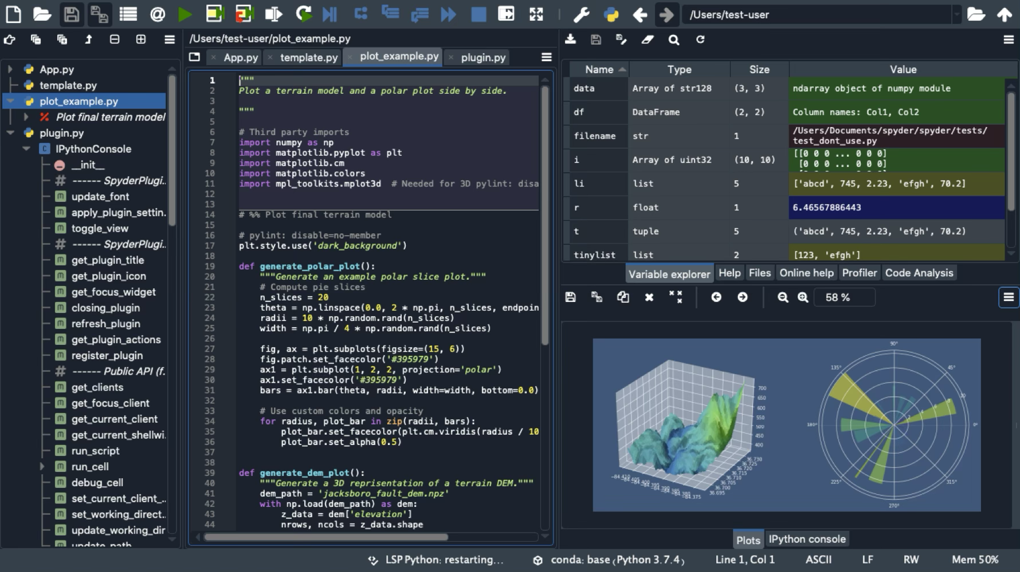
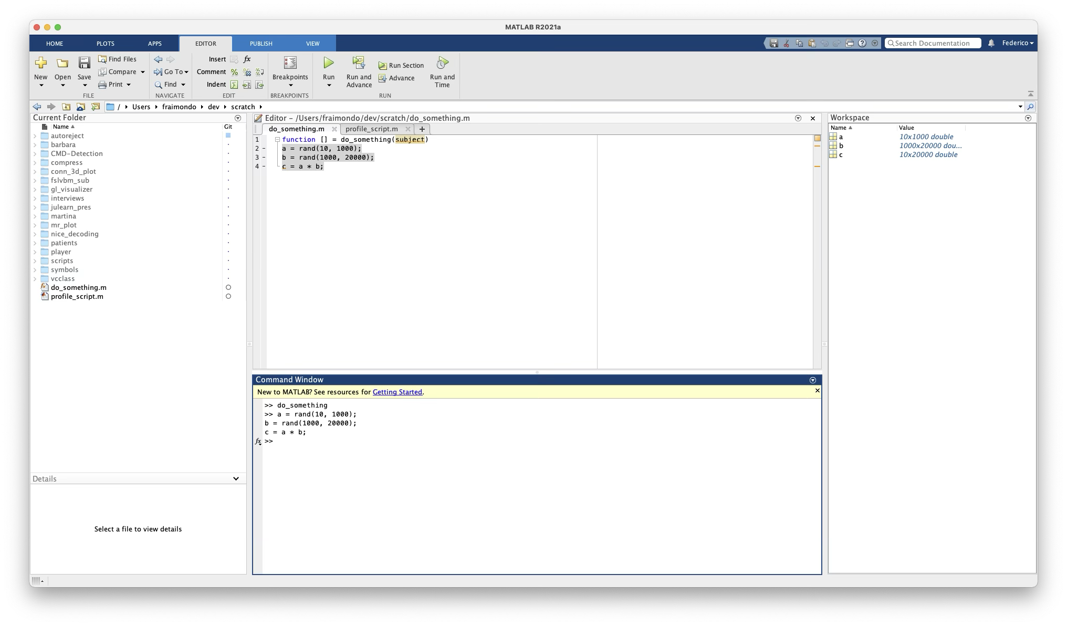
Integrated Development Environment (IDE)
Spyder
Matlab

Slide 20
Integrated Development Environment (IDE)
Debugger
Profiler
Linter
Syntax
Highligher
Variable
Explorer
Editor
File Browser
Terminal/Interpreter

Slide 21
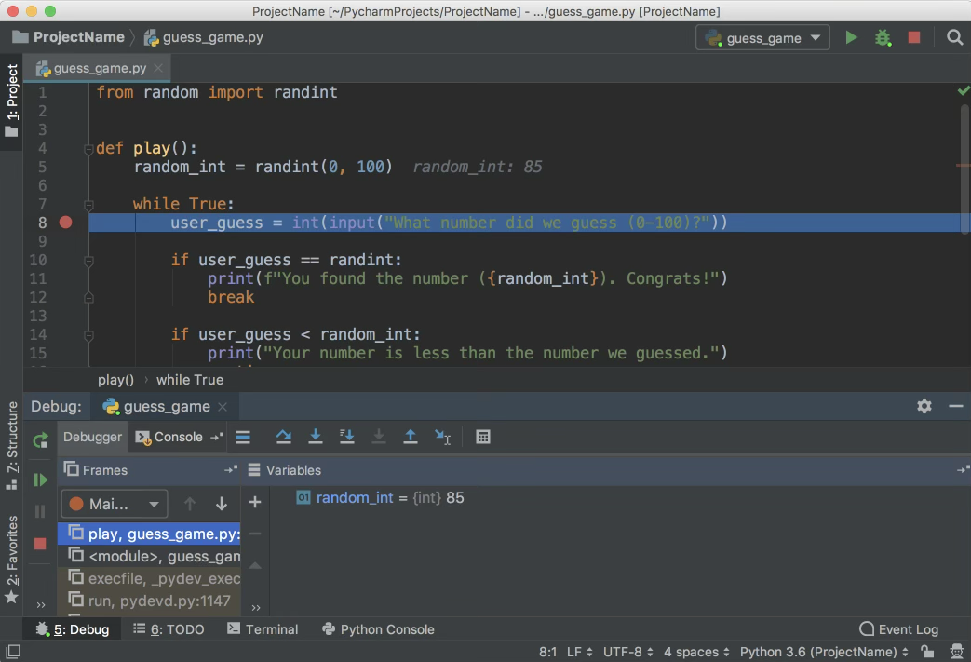
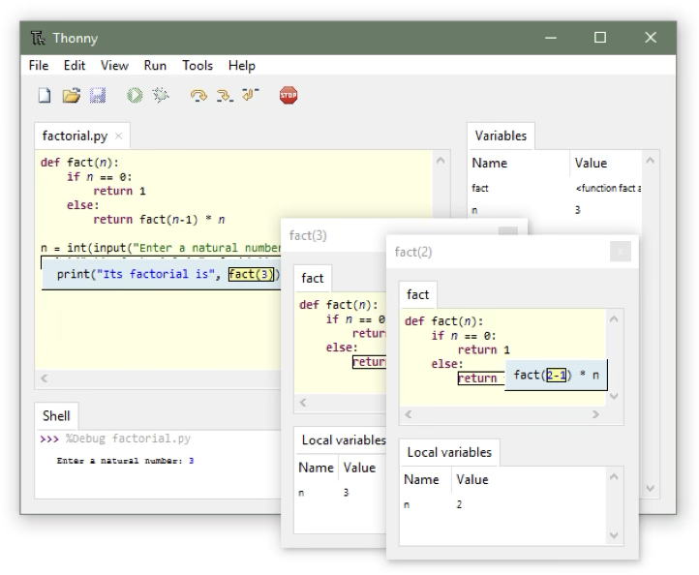
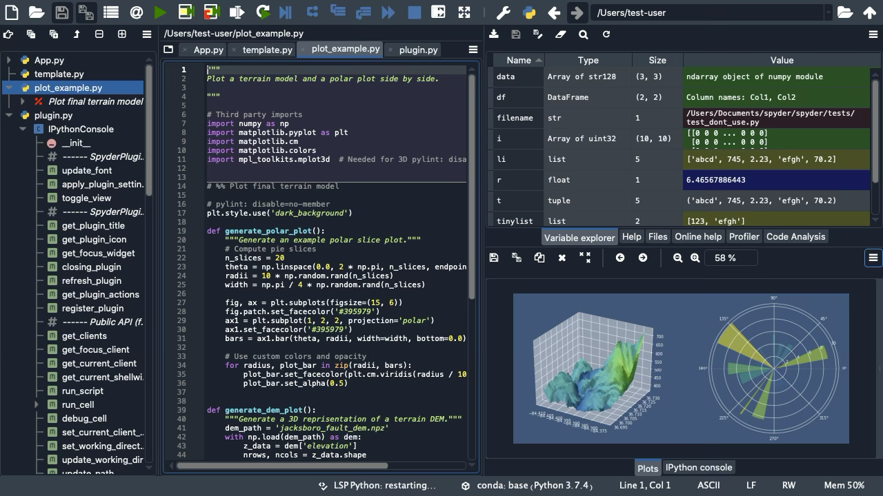
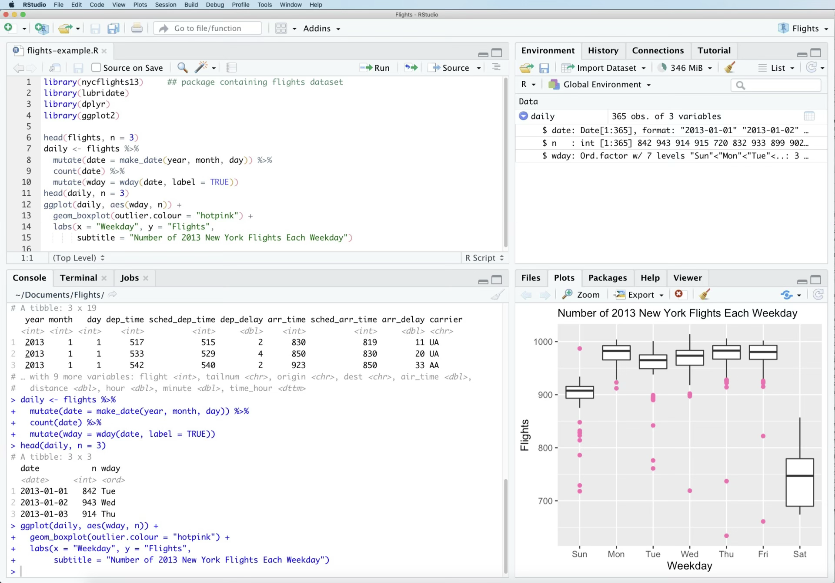
Integrated Development Environment (IDE)
Language Specific
Spyder
PyCharm
Thonny
Matlab
RStudio
Matlab

Slide 22
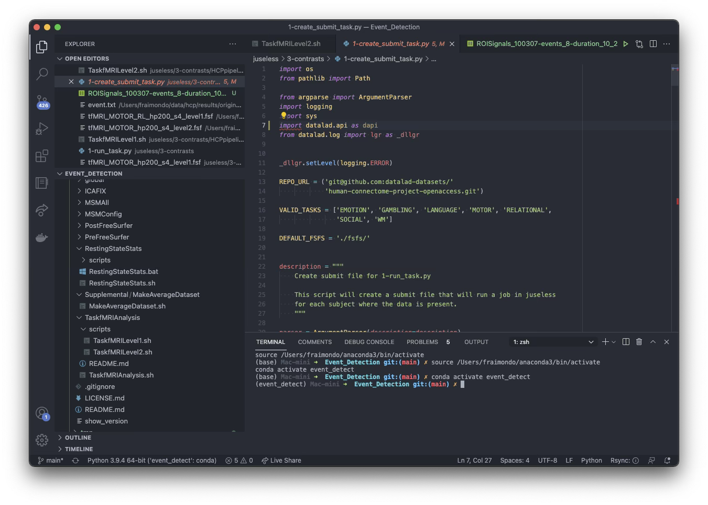
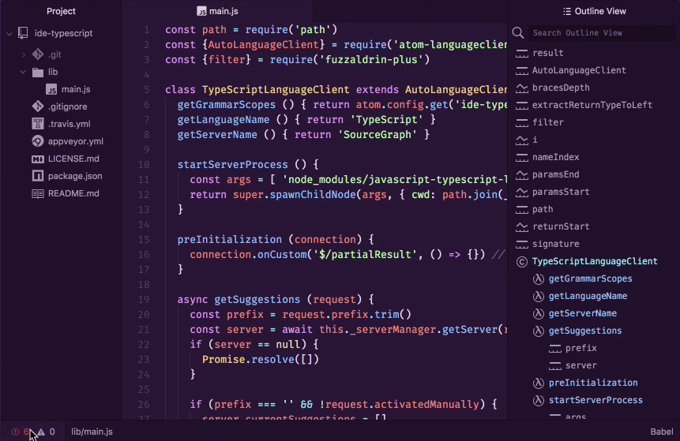
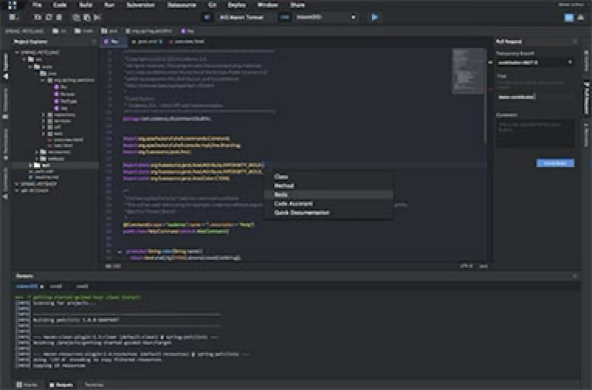
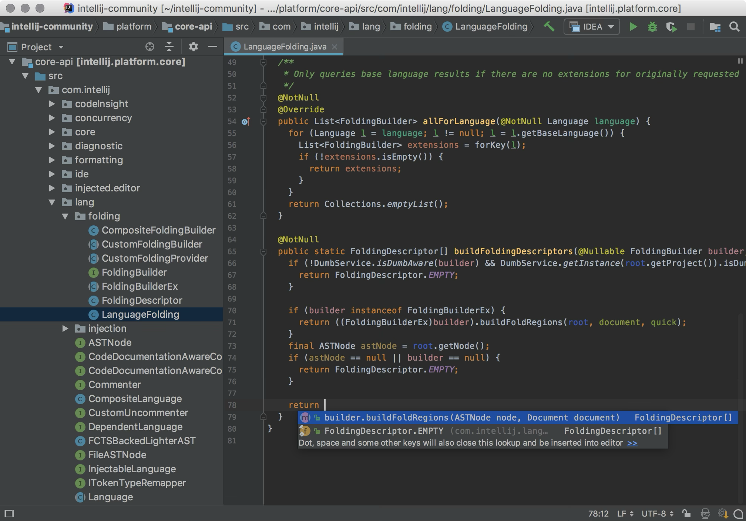
Integrated Development Environment (IDE)
Language Agnostic
Atom
Visual Studio Code
Eclipse
IntelliJ IDEA

Slide 23
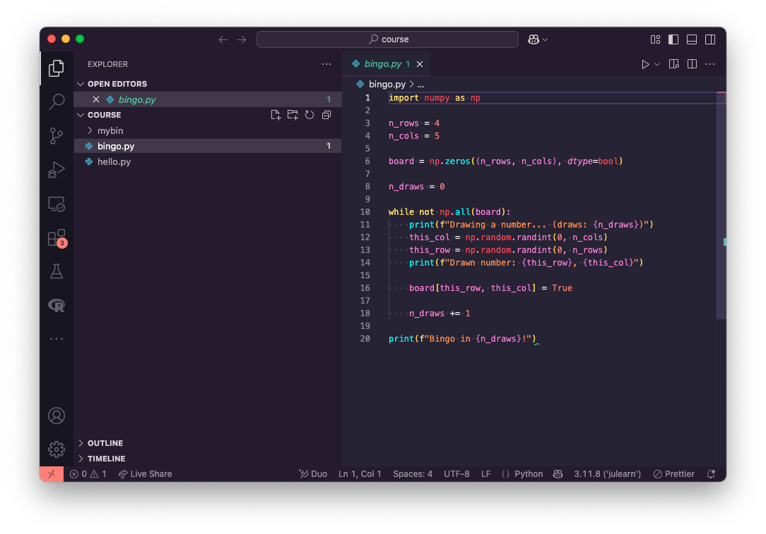
Bingo in VSCode

Slide 24
Bingo in VSCode
Python extension
Select environment
Ipython
Interactive python
Encapsulate:
Missing return error!
Wrong keyword error!
Problems
Add flake8
Add ruff

Slide 25
Summary
Python:
from the CLI (python)
Interactive Python (ipython)
Notebooks (Jupyter, #%%)
Platform
Runtine Environment
Development Environment
Package Managers
conda/mamba
Pip
Virtual Environments Managers
pipenv
virtualenv
conda/mamba
poetry
Integrated Development Environment
Visual Studio Code
Linter
Formatter

